Slide 1



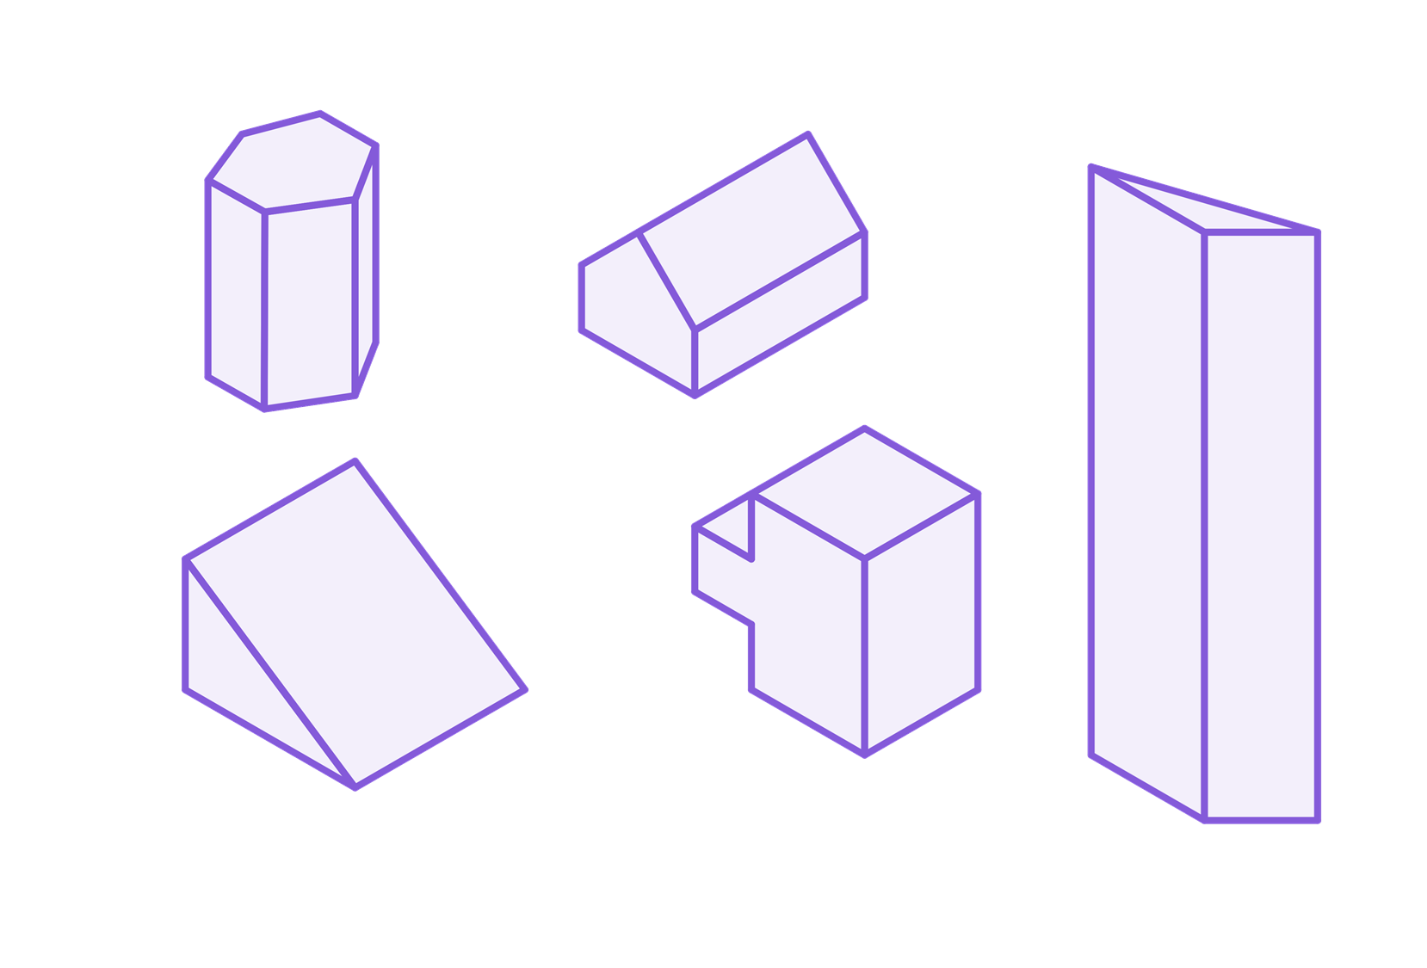
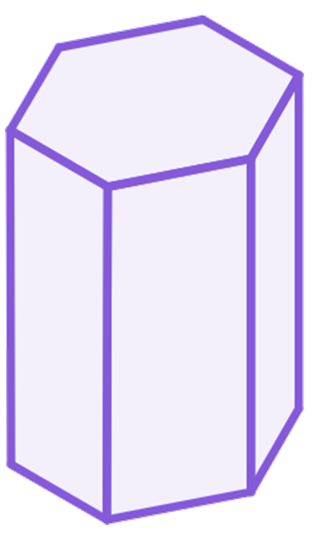
Volume of prisms
Task A: Calculating the volume of any prism
1) Sketch all the cuboids with integer lengths, that have a volume of 18 cm³
2) Calculate the volume of these cuboids
There are four cuboids with integer lengths 1 × 1 × 18
1 × 2 × 9
1 × 3 × 6
2 × 3 × 3
a)
4 cm
b)
2 cm
c)
3.2 m
2 cm
50 mm
3.2 m
= 5 cm
3 cm
4 m
3 × 2 × 4 = 24 cm³
1 cm
4 × 3.2 × 3.2
= 40.96 m³
5 × 2 × 1 = 10 cm³
3) There are pairs of shapes with the same volume. Which shape does not have a pair?
2 cm
9 cm³
1 cm
Area
= 3 cm²
1 cm
2 cm
1 cm
3 cm
1 cm
1 cm
1 cm
4 cm
2 cm
3 cm
14 cm³
2 cm
14 cm
9 cm³
12 cm³
2 cm
14 cm³
3 cm
3 cm
2 cm

Slide 2
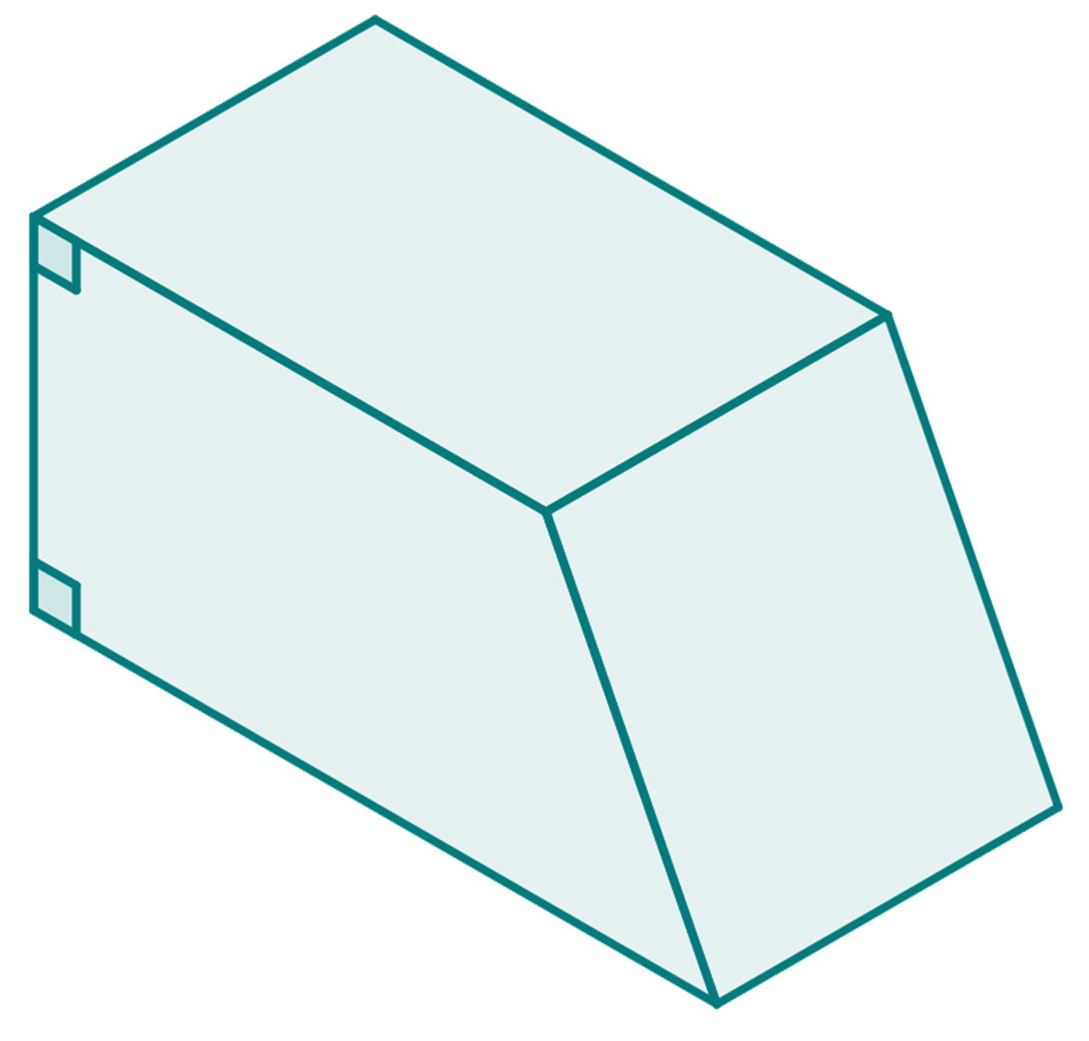

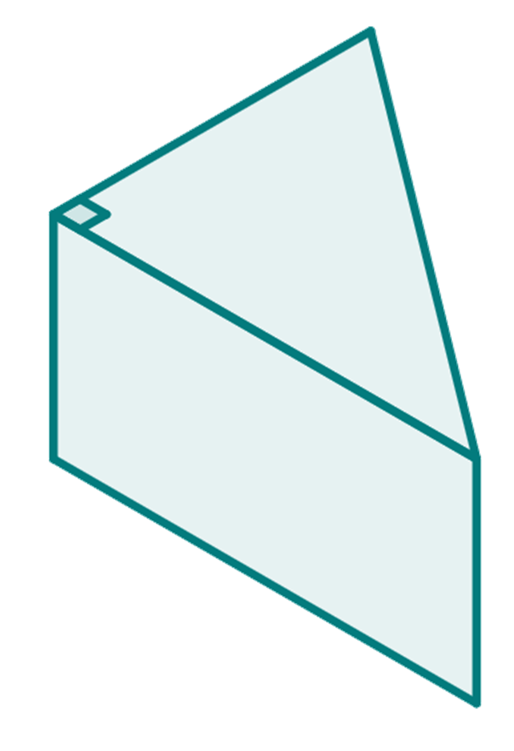
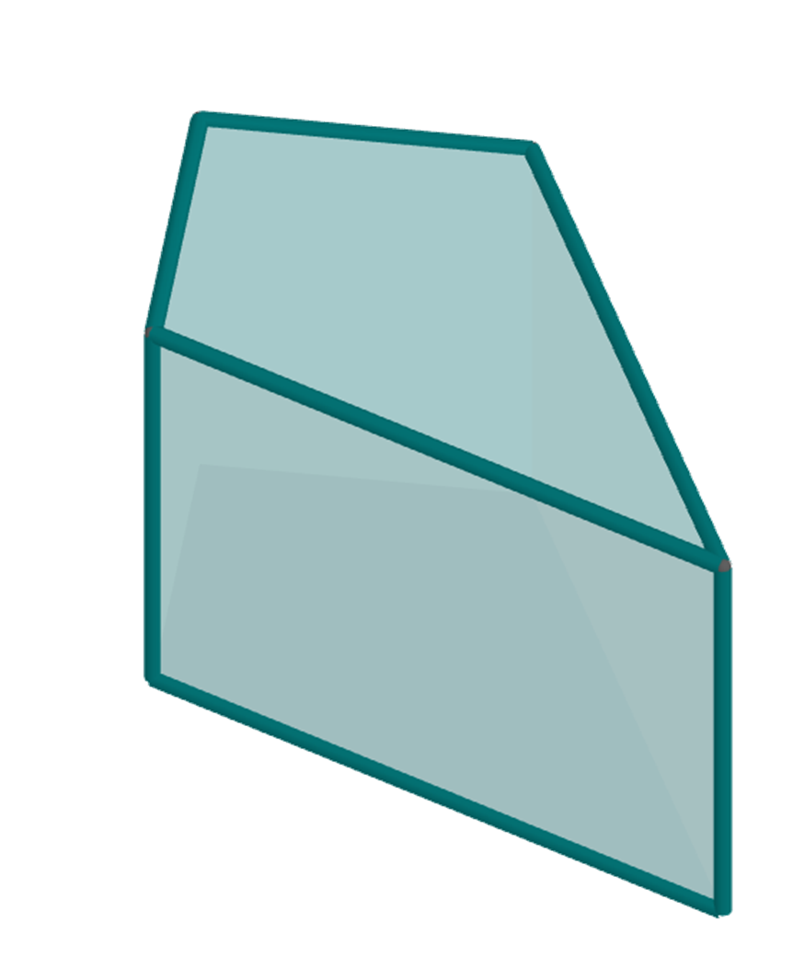


Volume of prisms
Task B: Using the volume of a prism
1) Complete the missing parts of the calculation.
7.5 m
( × (12.5 + ) × x) × 5 = 300
7.5
x m
( × × x) × 5 = 300
20
10x =
60
6
12.5 m
x =
5 m
Volume = 300 m³
2) Both prisms have a volume of 378 mm³. Work out the missing length in each prism.
a mm
6 mm
21 mm
7 mm
b mm
12 mm
( × 12 × a) × 7 = 378
21 × 6 × b = 378
6a × 7 = 378
126b = 378
42a = 378
b = 3
a = 9
3) Prism A and prism B have the same volume. Work out the missing length of prism B.
12 cm
9 cm
Volume of prism A = volume of prism B
A
( × (12 + 9) × 4) × 15 = (8 × 6 + 14 × 3) × x
4 cm
15 cm
3 cm
630 = 90x
7 = x
8 cm
B
22 cm
6 cm
x cm
Mathematics in Education and Industry.
v2.2

